Slide 1






IAMD COE
FINANCIAL FOOTPRINT
(Apr 20 – Sep 21)
Cpt (OF-2) Evangelos BALTADOROS, GRC Army
Financial Controller
5’

Slide 2

Topics
IAMD Financial Footprint
  Definition - Approximation
  Assumptions - Breakdown
  Presentation
  Summary

Slide 3


IAMD COE FINANCIAL FOOTPRINT
Definition –
Approximation
Assumptions –
Breakdown
Summary
What does the IAMD COE Financial Footprint represent?
The expenditures and the incomes caused by the establishment and operation of the IAMD COE.
What does the Financial Footprint mean for an organization?
The financial “added value” to the economy based on the existence and operation of the organization.
Why is this a tool?
By keeping historical data of the footprint, besides the typical Financial Statements and Reports, simplified information concerning the financial performance of the organization is provided.

Slide 4
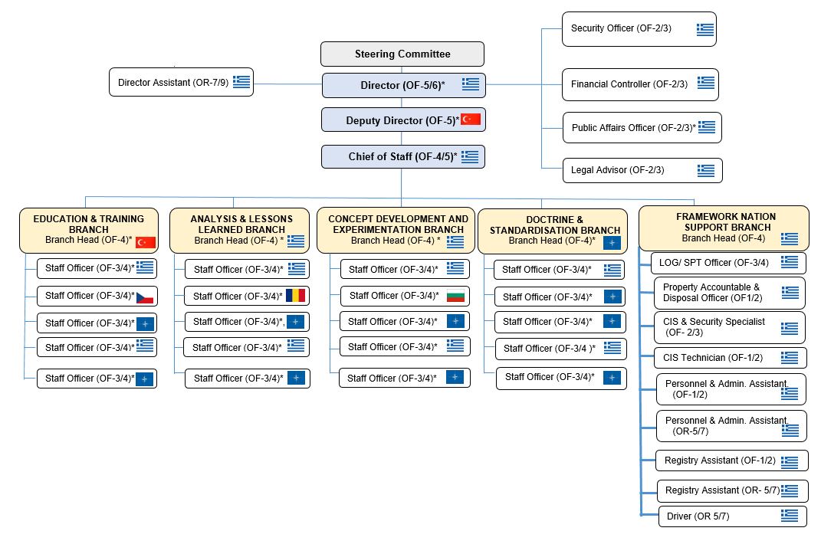





IAMD COE FINANCIAL FOOTPRINT
Definition –
Approximation
Presentation
Summary
Assumptions –
Breakdown
POSTS
ASSUMPTIONS
1
1
27
1
2
32

Slide 5
IAMD COE FINANCIAL FOOTPRINT
Definition –
Approximation
Assumptions –
Breakdown
Presentation
Summary
PERSONNEL
FINANCIAL
FOOTPRINT
POSTS
PERIOD
FN EXPENSES
228.075,39 €
(as Financial Statements 2020)
1.500 €
From establishment
Apr 2020
Monthly average
To date
SHARED COSTS
Private expenses
Sep 2021
50.000 €
(forecast for period Jan 2021-Sep 2021)
Family expenses
18 months
32
14 x 1 x 1.500 = 21.000
11 x 1 x 1.500 = 16.500
778.500 €
18 x 27 x 1.500 = 729.000
1 x 1 x 1.500 = 1.500
3,5 x 2 x 1.500 = 10.500
(average months assigned posts) x (assigned posts) x 1.500

Slide 6

IAMD COE FINANCIAL FOOTPRINT
228.075,39 €
1.057.000 €
50.000 €
778.500 €
NATO UNCLASSIFIED Releasable to Public

Slide 7

IAMD COE FINANCIAL FOOTPRINT
Definition –
Approximation
Assumptions –
Breakdown
Presentation
Summary
1.057.000 €
IAMD COE
Crete

Slide 8

Questions

